Slide 3
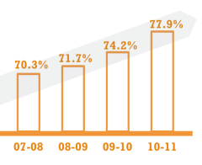
Information
Instruction
Student Information and Learner Profile
Instructional Design, Practice & Resources
Data Analysis and Reporting
Educator Effectiveness: Evaluation and Professional Development
Assessment
Information
a simpler, better information system to replace NC WISE
Integrated Instructional Solution
a new standards-aligned tool for instruction (e.g. lesson plans, unit plans), assessment and data analysis
Effectiveness
a simpler, better online evaluation system and new professional development system
PowerSchool
Student
Information
Schoolnet
Instructional
Tools and
Assessment
OpenClass
Collaboration
Test Nav
Summative Assessment
Truenorthlogic
Evaluation and PD

Slide 4
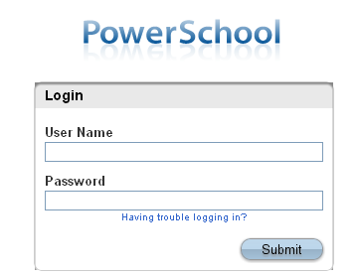
Attendance
Student Information
Scheduling
Grade book (report card)
Transcripts
Replaces Performance Matters & Orca

Slide 5
Grade Book
Report cards
Enter Assignments
Acts as Profile Card
More training on this on September 6th

Slide 6
You need to use Mozilla Firefox
Download it here
http://www.mozilla.org/en-US/firefox/new/

Slide 7
How do I get there?
www2 under applications OR
http://ps.wcpss.net/ OR
http://annettesteele.weebly.com/useful-links.html OR

Slide 8
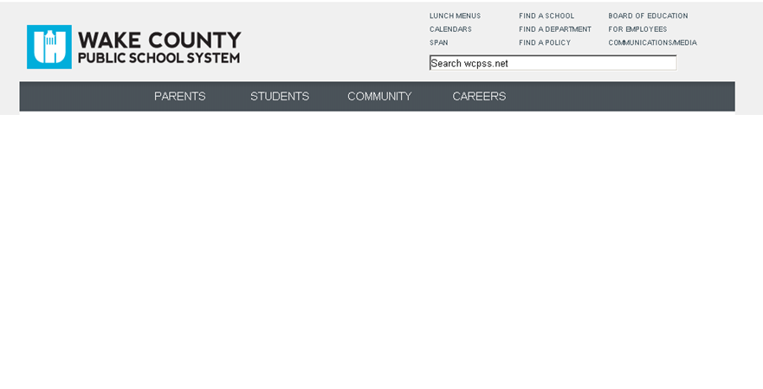
How to Access From Home http://www.wcpss.net/

Slide 9
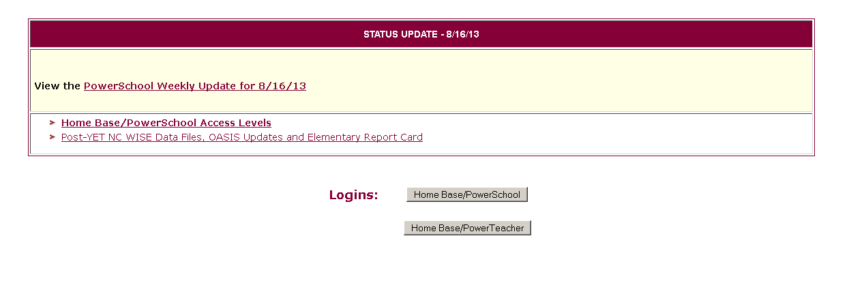

Slide 10
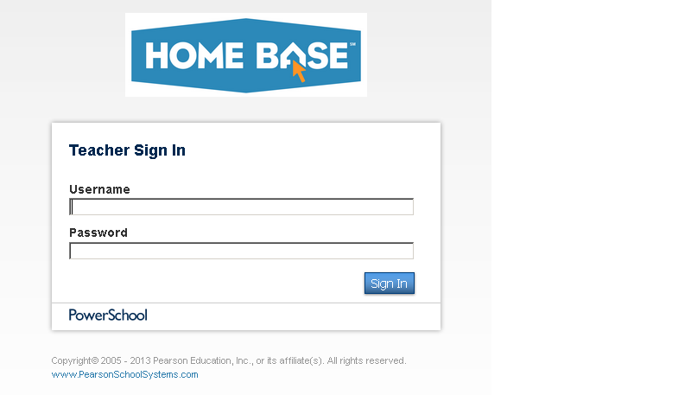
Username: wcpss000000
Your 6 digit employee number
If yours is only 5 add a zero in front
Password: your email password

Slide 11
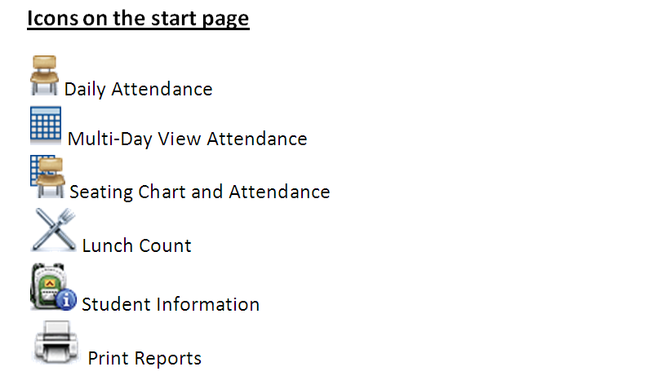
How to Take Attendance
Video : https://wcpss.edmodo.com/folder/1337870

Slide 12
How to Take Attendance
Click on the chair icon next to the homeroom class.
Use the dropdown menu under date to select the correct date.
If all students are present you only have to click on the submit button.
If a student is absent click on the white box beside his/her name and use the dropdown menu to code their absence.
You can enter in a comment by clicking on the grey box. The comment screen will open. When you are finished click ok and that absence/tardy will have a comment attached to it.

Slide 13
How to Take Attendance
I would suggest using the icon to take attendance by single day only because it is easier.
There are other ways to set up your seating chart and use multi-day attendance but I think the single day is the easiest and the safest for making sure it is completed.

Slide 14
How to Access Student Information
Click on the backpack icon beside your homeroom class.
Click on the student’s last name on the left side of the screen.
On the right side of the screen under the blue line you will see a dropdown menu that says select screen.
Click on that and change it to quick lookup.
This is where any medical information, custody information, etc. will be kept. Click on the icons beside the student’s name to determine what important information there is for that child.
To return to the start page click on the words POWER TEACHER at the top of the page.

Slide 15
How to View Reports
This only needs to be done one time.
On Your computer go to:
Start
Programs
Click Adobe reader 9
Wait until you see the adobe reader window

Slide 16
Attendance Grid for Substitute Teachers
From the start page click on Gradebook on the left
side of the screen
Click on the reports icon at the top of the screen
Click on the grey arrow beside attendance grid
Click on the grey calendar beside start date to change
the date
Do the same for the end date
Click open report then you can print
by clicking on the print icon

Slide 17
Report for Student Check Off
From the start page click on Gradebook on the left side of the screen
Click on the reports icon at the top of the screen
Click on the grey arrow beside student roster
You can choose any information you would like
(student name, number, birthday, grade level,
phone number, parent information,
and any custom information you would like)

Slide 18
Report for Student Check Off (Continued)
To put your custom information into the report click extra class
column and choose from your custom information.
This report would be good for the RED BAG.
If you only want the student’s name and check
off boxes click only the box for student name.
Check the box beside the number of blank boxes you want.
You can also type in the heading for the boxes.
Click run report then you can print it by clicking on the printer icon.

Slide 19
How to Input Custom Information for Students
From the start page click on Gradebook on the left side of the screen
Click student information at the top of the screen
Click extra class column
Highlight custom 1 and click edit
Type in whatever custom column you want (parent email address,
mom cell, dad cell etc.) then click close
To add the student information go to the column you want to change and double click the box beside the student’s name then type
Click save to close

Slide 20
GRADE BOOK
Report cards
Create & record
assignments
Acts as profile card
All Teachers are required to use the PowerTeacher Gradebook

Slide 21
All Teachers are required to use the PowerTeacher Gradebook.
For those of you who are ready to explore, check out these videos…
https://wcpss.edmodo.com/folder/1337870
PowerSource (https://powersource.pearsonschoolsystems.com) should be viewed prior to training:
· PowerTeacher
· PowerTeacher Gradebook: Getting Started
· PowerTeacher Gradebook: Working with Grades
· PowerTeacher Gradebook: Analysis and Reporting
· PowerTeacher Gradebook Standards
·

Slide 22
All Teachers are required to use the PowerTeacher Gradebook.
For those of you who are NOT ready to explore…
Breathe Easy!
We will take it slow!

Slide 23
Things to consider in your grade level:
Deadlines should be established for entering assignments into the Gradebook (i.e., weekly, biweekly)
PLTs should work to create common assignments that will be entered into the Gradebook
Conversations need to take place to align grading practices to standards-based grading
How often will work habits/conduct assignments be entered and graded in the Gradebook to align with the 1-3 rubric?
How will we ensure the work samples and behavior reports sent home align to the scores recorded in Gradebook?

Slide 24
NEXT STEPS
Please bring with you some graded assignments to training on September 6th
^{REMEMBER}
IF YOU USE A PAPER GRADEBOOK YOU WILL BE REQUIRED TO TRANSFER ALL GRADES AND ASSIGNMENTS
INTO PowerTeacher!

